Slide 1
Integrative Team Project
Team: SOFA
Members: Steven, Obaidah, Fang, and Angela

Slide 2
Table of Contents
General table
Steven’s Project Idea and Description
Obaidah’s Project Idea and Description
Fang’s Project Idea and Description
Angela’s Project Idea and Description
Selected Project Idea

Slide 3
General Table
Project Ideas | Description
Steven: Gravity and Orbits attraction simulator | Program that allows user to select planets and displays an animation of their interactions.
Obaidah: Math teaching program for students | Program that teaches students mathematical concepts interactively
Fang: Ideal gas law device | Program that visualizes how the particles of the gas act as different variables
Angela: Chemical structure generator | A program that generates chemical structures according to the inputted molecule
Selected idea: Gravity attraction and Orbits simulator | A program that simulates the gravity and interaction between celestial bodies

Slide 4
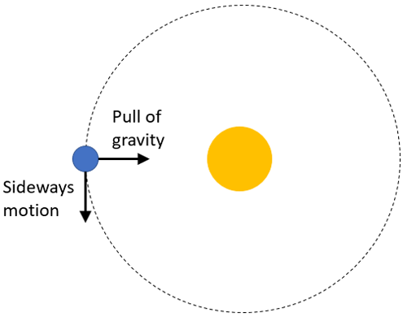
Steven’s Project Idea and Description
Project idea: Gravity attraction and Orbits simulator
Description: A program that simulates the gravity and interaction between celestial bodies. It shows how they attract each other depending on different parameters and selectable options. Adjusting these parameters will show changes in real time.
Input: Mass, initial velocity, distance, amount of planets
Output: Planet orbits, attractions, potential collisions, current velocity and force, graphs
Image source: https://www.google.com/url?sa=i&url=https%3A%2F%2Fwww.sciencebuddies.org%2Fteacher-resources%2Flesson-plans%2Fmodeling-gravity&psig=AOvVaw1RpmpKKLPDpMunBrZtfCKo&ust=1738257066877000&source=images&cd=vfe&opi=89978449&ved=0CBQQjRxqFwoTCJjU8762m4sDFQAAAAAdAAAAABAE

Slide 5
Obaidah’s Project Idea and Description
Project idea: Math teaching program for students
Description: A program that teaches students mathematical concepts using graphics. It shows each step of the calculation process and provides feedback in text and image form. The program guides the user through every part of the problem. It uses arrows, circles, and other symbols to point at different parts of the problem to help the user learn the concept.
Software design pattern: MVC
Input: Equation/question to be solved
Output: Step-by-step solution with arrows, circles, colors, etc.
Components: Java programming language, JavaFX, external images/files
Feasibility: Available libraries and packages in JavaFX; JavaFX supports event-driven programming; animations; graphics

Slide 6
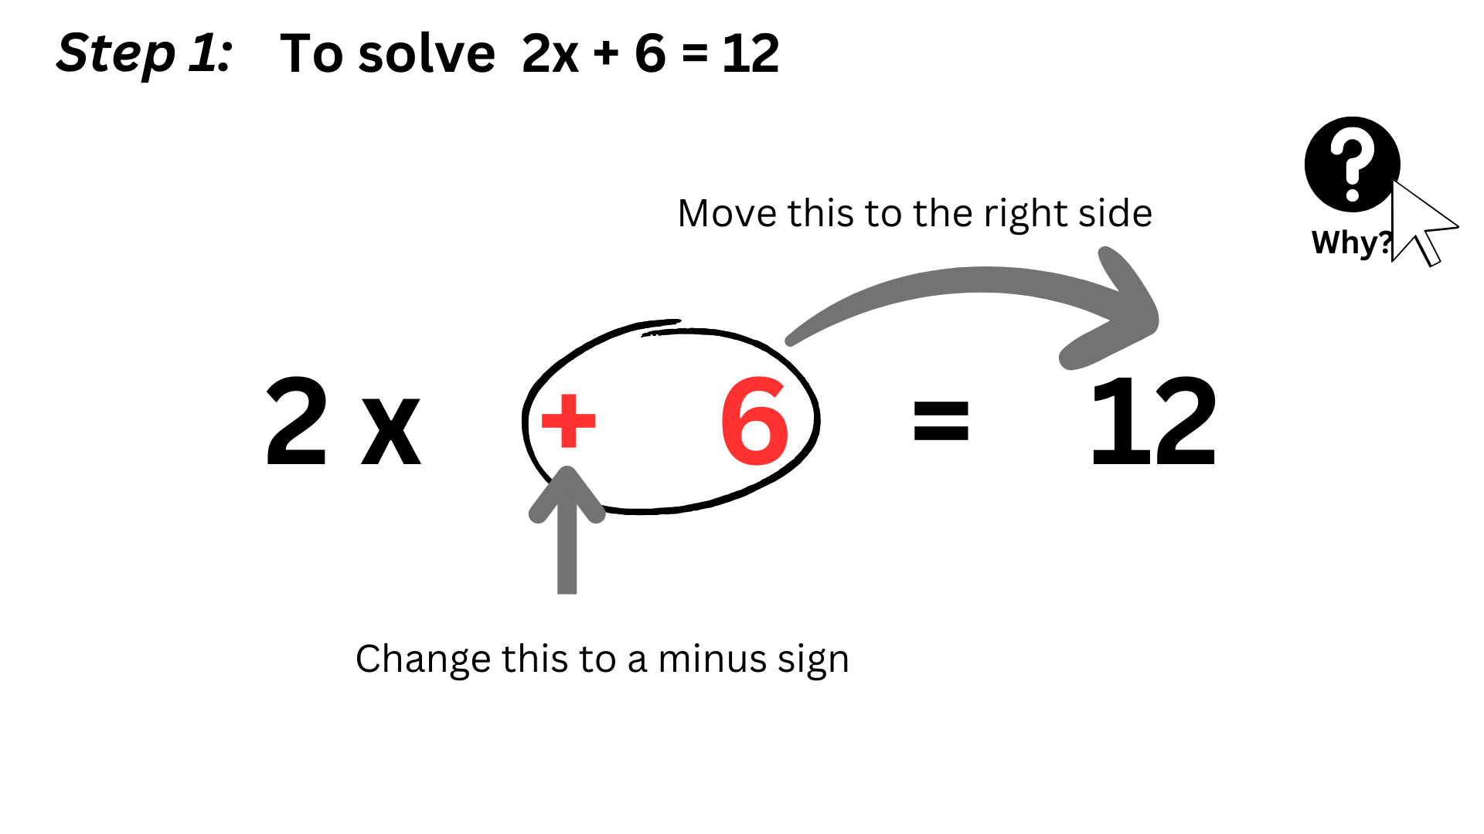
For illustration (not wireframe):

Slide 7
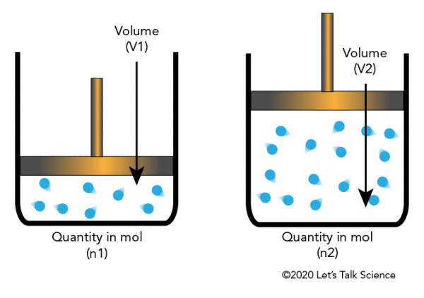
Fang’s Project Idea and Description
Project idea: Ideal gas law pressure device
Description: A program that allows the user to visualize how the particles of the gas act as different variables such as temperature, volume, and number of moles of gas change. The user can also add different types of gases shown in other colors into the container and observe its effect on the pressure.
Input: Volume, temperature, number of moles, or pressure.
Output: Animation of the particles, and dependent variables.
Image Source:
https://letstalkscience.ca/educational-resources/backgrounders/avogadro-and-ideal-gas-law

Slide 8
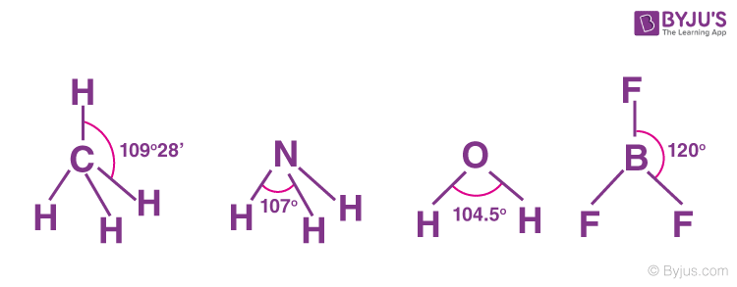
Angela’s Project Idea and Description
Project idea: Chemical structure generator
Description: A program that generates chemical structures according to the inputted molecule. The program will take into consideration all the exceptions and laws. It will display the structure with bond angles and Lewis dots structure.
Input: Molecule name/symbol, Compound name/symbol, Polyatomic Compound name/symbol
Output: Chemical Structure, Bond Angle
Image Source: https://byjus.com/jee/chemical-bonding/

Slide 9
Selected Project Idea: Gravity and Orbits
Project idea: Gravity attraction and Orbits simulator
Reasons:
Related to science
Interactive
Doable through JavaFX
Combines different disciplines (physics, math, programming)
Interesting & challenging

Slide 10

Concepts
Newton's Law of Universal Gravitation:
$F=G\frac{m_{1}m_{2}}{r^{2}}$
Newton's Second Law of Motion:
$F=ma$
Vectors and Calculus:
For gravitational forces, accelerations, velocities in 2d space

Slide 11
Core Input & Output
Input:
Planet’s Initial Velocity: magnitude + direction
Planet’s Mass
Planet’s Position
Output:
Animation of the Planets and their Path
Vectors of Acceleration & Velocity

Slide 12
Feasibility: JavaFX Implementation
JavaFX elements:
Shapes: Circles, Lines, Triangles
Panes
Sliders
Frame-by-Frame Animation:
60 Frames per Second
Position Updates Every Frame
Calculated Using Math & Physics
Timeline: Around 12 weeks
1st quarter: Set up initial UI elements
2nd quarter: Apply logic and physics
3rd quarter: Data flow connections and finalize UI
4th quarter: Debug and polish

Slide 13
Individual Parts
(Pair 1) Obaidah: UI
(Pair 1) Fang: Logic and physics
(Pair 2) Steven: Data flow
(Pair 2) Angela: Animation

Slide 14
Thank you for listening!

